Slide 1
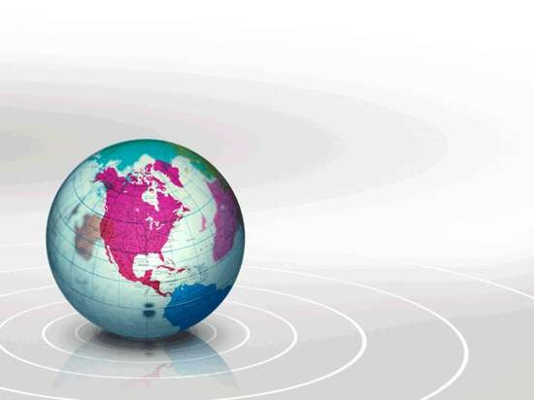
URBANIZATION AND HEALTH

Slide 2
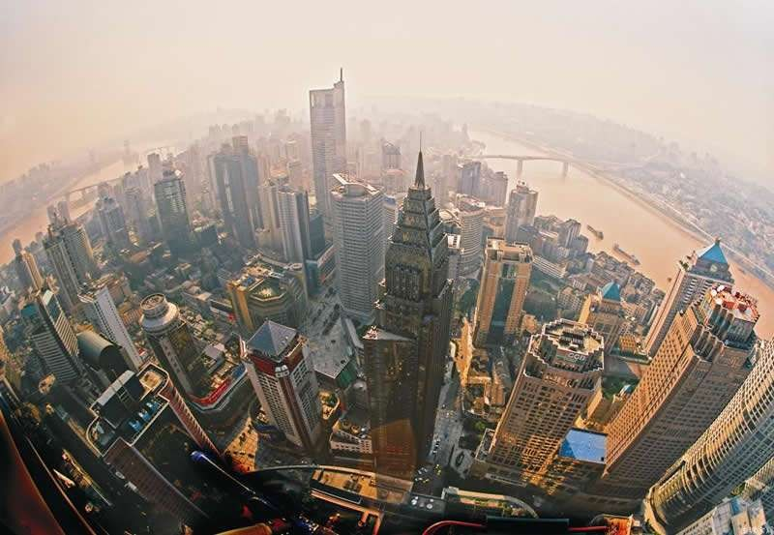

Slide 3
INTRODUCTION
 In the past, the emphasis of environmental action has often been on wilderness, wildlife, endangered species and the impact of pollution on natural landscapes outside cities.
 Now the focus of attenttion is to the city environments. City dwellers are at the center of some of the most important environmental issues.

Slide 4
 Urbanization is an inevitable phenomenon that accompanies the development of a country.
 Worldwide are becoming an increasingly urbanized species.
 The rapid urbanization of the world’s population over the
twentieth century is described in
the 2005 Revision of the UN World Urbanization Prospects report.

Slide 5
 Urbanization is defined as the process of human movement and centralization towards and into cities and urban areas, with the associated industrialization, urban sprawl and lifestyle that brings.
 Urbanization does not only involve the movement of people from rural to urban areas but also comes about as a result of natural increases in the urban areas.

Slide 6
 The global proportion of urban population rose dramatically from 13% (220 million) in 1900, to 29%
(732 million) in 1950, to 49% (3.2 billion) in 2005. It is projected that 62% of the population, 6.5 billion people will live in cities by 2025.

Slide 7
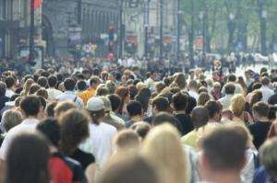

Slide 8
 According to the UN State of the World Population 2007 report, the majority of people worldwide will be living in towns or cities, for the first time in history; this is referred to as the arrival of the "Urban Millennium" or the 'tipping point'.
 In regard to future trends, it is estimated 93% of urban growth will occur in developing nations, with 80% of urban growth occurring in Asia and Africa. It is estimated that by 2015 there will be 36 megacities (more than 8 million residents), 23 of them in Asia.

Slide 9
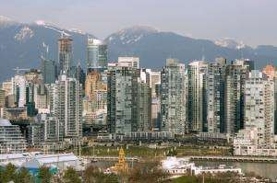
According to a new report, humans are building the equivalent of a city the size of Vancouver (shown above) every week.
(Credit: iStockphoto/Dan Barnes)

Slide 10
 With the growing human populations, we can imagine two futures.
 In one, cities are pleasing and liveable, use resources from outside the city in a sustainable way, minimize pollution of the country and allow room for wilderness, agriculture and forestry.

Slide 11
 In the other future, cities continue to be seen as environmental negatives and are allowed to decay from the inside.
 People flee them to grander and more expansive suburbs that occupy much land, and the poor who remain in the city live in an unhealthy and unpleasant environment.

Slide 12
 Although such a city appears to its inhabitants to grow stronger and more independent, it actually becomes more fragile.
 Ironically, without care for the city, it pollute even more than in the past.
 A city grows at the expense of surrounding countryside, destroying surrounding landscape on which it depends. A nearby areas are ruined for agriculture and the transportation network extends, the use, misuse and destruction of the environment increase.

Slide 13
THE CITY AS AN ENVIROMENT
 A city changes the landscape and because it does, it also changes the relationship between biological and physical aspects of environment.
 A city creates an environment that is different from surrounding areas. City change local climate; they are commonly cloudier, warmer and rainier than surrounding areas.

Slide 14
 In a city, everything is concentrated, including pollutants.
 City dwellers are exposed to more kinds of toxic chemicals in higher concentrations and to more human- produced noise, heat and particulates than are their rural neighbors.
 In general, life in a city is riskier because of higher concentrations of pollutants and pollutant-related diseases.

Slide 15
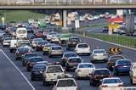
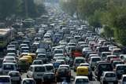

Slide 16
 For example, lives are shortened by an average of one to two years in the most polluted cities in the United States.
 The city with greatest number of early deaths is Los Angeles, with an estimated 5, 973 early deaths per year, followed by New York with 4,024, Chicago with 3,479 and
Philadelphia with 2,590.

Slide 17
URBAN CHARACTERISTIC
 Urban area are characterised by their high density population, who are accomodated by the development of extensive road networks, housing schemes, service and production industries and recreational facilities.

Slide 18
 However, in low and middle income countries with rapid urbanisation, there are areas which large increases in population density, an uncontrolled increase in pollution (air and water) and a lack of basic infrastructure (health care, water, sewerage and waste disposal).
 The increasing concentration of people in urban centers has strained the capacity of most governments to provide basic services. Illegal slums and settlements are common. The number of people living in slums and shanty towns represent about one-third of the people living in cities in developing countries.

Slide 19
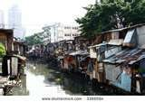
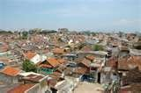

Slide 20
 In such areas, people are usually deprived of access to the basic facilities of drinking water and waste disposal. Resources are not adequate for removal or disposal of waste.
Residents have little access to facilities which make for a reasonable quality of life and human development.

Slide 21
\
 Thus they often suffer from greater exposure to dust, unpleasant smells, chemicals and noise pollution, and the nature of dwelling makes them less able to withstand such hazards.
 There is direct link between people dwelling in such conditions and cholera, viral hepatitis, typhoid fever, schistomiasis, diarrhea and parasitic diseases that are carried by water or poor sanitation, overcrowding and poor diet.

Slide 22
 These circumstances have meant a rise in these areas of communicable diseases, known as the ‘diseases of poverty’ including malaria, respiratory diseases, nutritional deficiency and drug-related illness.

Slide 23
 For example, in Zambia, the most urbanized country in the African region, water-borne diseases such as cholera and dysentery are prevalent due to lack of access to clean water and bad sanitation.
 More than half of the Mozambican urban population lives in unsanitary and unhealthy conditions and the levels of urban unemployment are extremely high. The unhealthy conditions are putting a huge strain on the country’s health system.

Slide 24
 They are also exposed to health risks of modern cities – traffic, pollution etc., and suffer the consequences of social and psychological instability as the traditional support structures of rural areas steadily disappear.
 Writing in the "Anatolian Journal of Psychiatry" in 2008, M. Tayfun Turan and Asli Besirli found that the social problems associated with urban societies, the traffic problems and the general anxiety about the future contributed to an increase in mental health disorders.

Slide 25
URBANIZATION AND HEALTH
 Urbanity and health involves the connection between urban life and the living conditions affecting human health.
 Urbanization affects human health in several ways, from dietary patterns to the physical environment. The concentration of people in urban areas, with a multitude of economic activity including industrial production and extensive transportation, contributes to air pollution, which is a major health hazard.

Slide 26
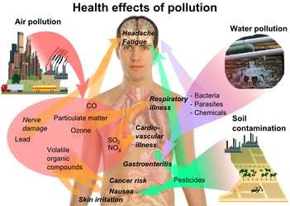
Figure 1 Health effects of environmental pollution

Slide 27
 Although urbanization allows more accessibility to health services, it also creates health hazards. In poor parts of the cities, health problems include inadequate water and sanitation, limited or no waste disposal and poor air quality, as well as crowded living conditions and general poverty.
 Urbanization affects human health in several ways, from dietary patterns to the physical environment. The concentration of people in urban areas, with a multitude of economic activity including industrial production and extensive transportation, contributes to air pollution, which is a major health hazard.

Slide 28
 In such urban areas the air, land and water are often contaminated, spreading disease. In cities in the more affluent parts of the world, health hazards resulting from urbanization are mainly connected to air pollution, as well as crime, traffic and lifestyle.
 Some problems connected to the urban physical environment affect virtually everyone, particularly air pollution. The burning of fossil fuels from transportation, industry and energy production is the main culprit regarding outdoor urban air pollution. Another health hazard common in, but not exclusive to, the cities is connected to lifestyle and consumption patterns, including dietary changes and obesity.

Slide 29
CONCLUSION
 Cities offer the lure of better employment, education, health care, and culture; and they contribute disproportionately to national economies.
 However, rapid, unplanned and unsustainable patterns of urban development are making developing cities focal points for many emerging environment and health hazards.

Slide 30
 To make cities healthy, we must, all those who deal with aspects of the urban system that directly or indirectly affect health, involve themselves in urban health planning.
 Urban planning can promote healthy behavior and safety through investment in active transport, designing areas to promote physical activity and passing regulatory control on pollution and safety.

Slide 31
 Improving urban living conditions in the areas of housing, water and sanitation will go a long way to mitigate health risks.
 Building inclusive cities that are accessible and age-friendly will benefit all urban residents. Such actions do not require additional funding, but commitment to redirect resources to priority interventions, thereby achieving greater efficiency.

